Slide 1

Hello
Frontend Meetup Budapest, October
Barna Tóth | barna.toth@logmein.com

Slide 2
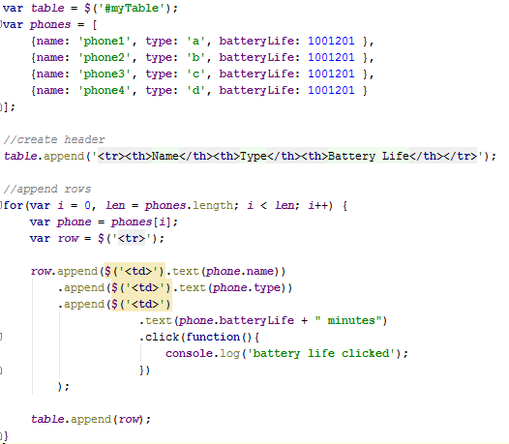
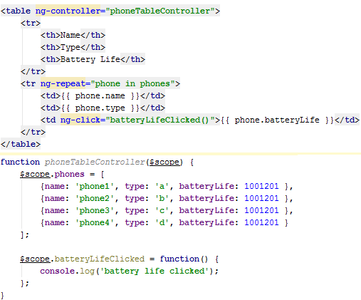
Why do we need templating?
jQuery
Was a big leap forward
Mark up nearly disappeared
Main mistake
Simple tasks became complicated and hard to read
Performance issues and vulnerabilities (XSS)
Templating
Easy to see through
Loose coupling between View and Controller
MVC
Easibly testable
Less code, more fun

Slide 3

Why AngularJS?
Developed by Google
Not only a MVC library but a whole framework
Support for a wide variety of browsers (even ie7)
Designed for testable code
Dependency Injection
Modularized
Routing
Built-in powerful features
Good Docs
Extension for HTML language

Slide 4

Robot Store Demo
https://github.com/Hacklone/HelloAngularJS-RobotStoreDemo

Slide 5

Questions?

